Slide 1
Bottlenecks:
Automated Design Configuration
Evaluation and Tune

Slide 2
goal
What has happened
Why it happened
Anticipate what will happen in the future

Slide 3
Architecture
Automated Staging
（AS）
Workload generator
VNF
………….
VNF
Monitor and
Analysis（MA）
WV
hypervisor
ODL
DAPP
Deployment and
Configuration（DC）
infrastructure
Workload generator and VNFs（WV）： workload generator generates workloads which go through VNFs
Monitor and Analysis（MA）：monitor VNFs status and infrastructure status to output analyzed results
Deployment and Configuration（DC）：deploy and configure infrastructure and WV
Automated Staging（AS） : implement automated staging

Slide 4
stages

Slide 5
Stage composed by steps：
Code generation
takes experiment configuration files as the input, and generates all necessary resources to automatically execute experiments
It is required to cover all scenarios
Executing experiments
Use the generated resources and control the experimentations，including platform deployment，VNF deployment，configuration，initialization，workload execution and data collection.
Data collection
Collect gigabytes of heterogeneous data for resources monitors（e.g., CPU, Memory, thread pool usage, and etc…), response time throughput and VNF logs.
The structure and amount of collected data vary depending on the system architecture，monitoring strategy, tools（benchmarks）, the number of deployed nodes and workloads.
It is required to have scripts to collect all kinds of data
Database（suggested by test group）
Json（？） MongoDB（？）
Data analysis（*）
Due to the magnitude and structure of the data，data analysis becomes a non-trivial task
It is required to develop tools which can understand the internal data structure and help to make data analysis efficient

Slide 6
Framework examples
Rally Framework for Yardstick
Software Testing Automation Framework (STAF)\
Run specified test cases on a peer-to-peer network of machines
aims to validate that the test case behaved as expected.
runs as a service on a network of machines. Each machine has a configuration file that describes what services the other machines may request it to perform (e.g., execute a specific program).
Auto pilot
On a single machine
Scalable Test Platform(STP)
STP is designed for many users to share a pool of machines
Provides no analysis tools
Benchmarks need to be changed to operate within the STP Environment

Slide 7
Bottlenecks framework
A framework to run benchmarks, Not just another benchmark
for automating the repetitive tasks of running, measuring and analyzing the results of arbitrary programs
Prepare the platforms( we can use the genesis to help us deploy the platform)
Deploy VNFs
Deploy monitor tools and record all data
Accuracy
The results need to be reproducible，stale and fair
Reproducible means that you can re-run the test and get similar results
This way if you need to make slight modification，It is possible to go back and compare results

Slide 8
Benchmarks and workload
Macro benchmarks: The performance is tested against a particular workload that is meant to represent some real-world workload.
Trace Replays. A program replays operations which were recorded in a real scenario, with the hope that it is representative of real-world workloads.
Micro benchmarks. A few (typically one or two) operations are tested to isolate their specific overheads within the system.

Slide 9
Benchmarks examples：
Web server benchmarks
ApacheBench (or ab), a command line program bundled with Apache HTTP Server
Apache JMeter, an open-source Java load testing tool
Curl-loader, a software performance testing open-source tool
Httperf, a command line program originally developed at HP Labs
OpenSTA, a GUI-based utility for Microsoft Windows-based operating system
TPC-W was a web server and database performance benchmark
CLIF, RUBiS, Stock-Online, RUBBoS, TPC-W
At the beginning, we can choose some of
these open source benchmarks to validate our framework

Slide 10
Monitor tools
Operf
Xenmon
Systat
Ganglia(for xen: GMond )
To be continued
We need more open sourced monitor tools
to help us to go to insight of system

Slide 11
Timeline
Each experiment is composed of 3 phases.
A warm-up phase initializes the system until it reaches a steady-state throughput level.
the steady-state phase during which we perform all our measurements.
Finally, a cool-down phase slows down the incoming request flow until the end of the experiment.
Notes:
Sysstat utility that collects CPU, memory, network and disk usage from the Linux kernel every second
Most benchmarks involve performing several workloads on several configurations.

Slide 12
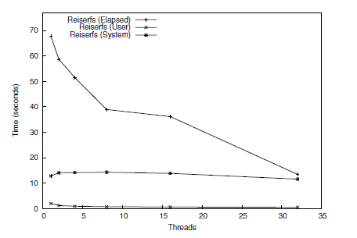
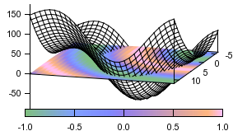
Data and graphs
CSV VS Json (used by test group)
Results are presented in a tabular format that can easily be imported into spreadsheets.
A bar and line graph script that generates graphs from tabular results using Gnuplot
Gnuplot
a portable command-line driven graphing utility for Linux, OS/2, MS Windows, OSX, VMS, and many other platforms

Slide 13
Test cases
E2E test cases
Cover multiple components in VIM and VNFI
Components test cases
KVM
Storage
ODL and ONOS
And so on
Test cases will cover NFVI and VIM
We will use the components test cases provided by other projects, such as KVM and storage
We will develop E2E test cases and other components test cases if needed

Slide 14
What we are doing
Developing framework
Generate codes
Used to control and run benchmark
Collect data and analysis data
Developing a E2E test case
Cover multiple nodes and scale well
show some bottlenecks examples
Used to validate the framework
next
We will discuss with community for next plan

